Slide 1

Sedgwick County Department of Corrections
1995 - 2023

Slide 2

1995
Programs
DOC Administration & Operations
  o Director’s office
  o Grants, Fiscal Management, Housekeeping, Food, Janitorial, and Maintenance Services
Juvenile Facilities
  o Juvenile Residential Facility
  o Juvenile Detention Facility
    Starting Point Prevention
    Home-Based Supervision
  o Judge Riddel Boys Ranch
  o Sedgwick County Youth Program
  Juvenile Intake and Intensive Supervision Program
Adult Intensive Supervision Program
  Pretrial Services Program
Adult Residential Services
The Sedgwick County Departments of Youth Services (est. 1985) and Community Corrections (est. 1983) were consolidated into the Sedgwick County Department of Corrections.

Slide 3
1998
Programs
DOC Administration & Operations
  o Director’s office
  o Grants, Fiscal Management, Housekeeping, Food, Janitorial, and Maintenance Services
Juvenile Facilities
  o Juvenile Residential Facility
  o Juvenile Detention Facility
    Starting Point Prevention
    Home-Based Supervision
  o Judge Riddel Boys Ranch
  o Sedgwick County Youth Program
  Juvenile Intake and Assessment Center
  Juvenile Field Services
  Juvenile Intake and Intensive Supervision
  Juvenile Case Management
Adult Intensive Supervision Program
Adult Residential Services
The Juvenile Intake and Assessment Center (est. 1996) and Juvenile Field Services (est. 1998) joined the Department of Corrections.

Slide 4
2006
Programs
DOC Administration & Operations
  o Director’s office
  o Grants, Fiscal Management, Housekeeping, Janitorial, and Maintenance Services.
Juvenile Facilities
  o Juvenile Residential Facility
  o Juvenile Detention Facility
    Starting Point Prevention
    Home-Based Supervision
  o Judge Riddel Boys Ranch
  o Sedgwick County Youth Program
  Juvenile Intake and Assessment Center
  Juvenile Field Services
    Juvenile Intake & Intensive Supervision
    Juvenile Case Management
Adult Intensive Supervision Program
Adult Residential Services
Criminal Justice Alternatives
  Pretrial Services Program
    Sedgwick County Drug Court
    Day Reporting Center
The Criminal Justice Alternatives (CJA) was formed and joined the Department of Corrections.
In 2004, the Criminal Justice Coordinating Council (CJCC) was formed to find efficiencies in the criminal justice system and develop and implement alternative programs designed to reduce recidivism, and provide adequate, well-run facilities.
The CJCC developed the Criminal Justice Comprehensive Master Plan for Sedgwick County which was adopted by the BOCC in 2005.

Slide 5
2017
Programs
DOC Administrative Services
  o Director’s office
  o Centralized Administrative & Business Services
  o Professional Development/Training
Juvenile Services
  o Juvenile Residential Facility
  o Juvenile Detention Facility
    Starting Point Prevention
    Home-Based Supervision
    Weekend Alternatives to Detention Program
  o Sedgwick County Youth Program
  o Juvenile Intake and Assessment Center
  o Juvenile Field Services
    Juvenile Intake & Intensive Supervision
    Juvenile Case Management
    Judge Riddel Boys & Girls Alternative Program
Adult Services
  o Intensive Supervision Program
  o Adult Residential & Service Center
  o Criminal Justice Alternatives
    Pretrial Services Program
    Sedgwick County Drug Court
Changes to organizational structure, programming and services, including-
Janitorial and Maintenance Services were centralized with Sedgwick County’s Division of Information and Operations.
In 2014, the Judge Riddel Boys Ranch was closed after nearly 50 years in operation due to lack of funding.
In 2015, the Judge Riddel Boys & Girls Alternative Program was opened.
Sedgwick County Youth Program (SCYP) was closed in 2017.
KDOC Reinvestment / Regional Grant Funding

Slide 6

2023
Programs
Administrative Services
  Director’s office
  Centralized Administrative & Business Services
  Continuous Quality Improvement / Professional Development
  Juvenile Services
  Juvenile Detention & Residential Facility
  Juvenile Intake and Assessment Center
    Coordination of Services – P.O.W.E.R. / Alternatives to Detention Programs
    Immediate Intervention Program – Serving pre-adjudicated / low-risk youth
  Juvenile Field Services
    Intensive Supervision, Case Management & Conditional Release
    Evening Reporting Center
    Home Base Services
Adult Services
  Intensive Supervision Program
  Adult Residential & Work Release Facility
  Criminal Justice Alternatives
    Pretrial Services Program
    Sedgwick County Drug Court
Changes to organizational structure, programming and services, including-
Renamed Department of Corrections & Department Branding Created
Evening Reporting Center (ERC) began offering evidence-based programming in 2018.
Immediate Intervention Programming (IIP) began serving pre-adjudicated / low-risk youth through JIAC.
KDOC Evidence-based funding grants started in 2020
Juvenile Residential Facility was temporarily closed due to staffing shortages in April 2022 and reopened at a limited capacity in May 2023.

Slide 7
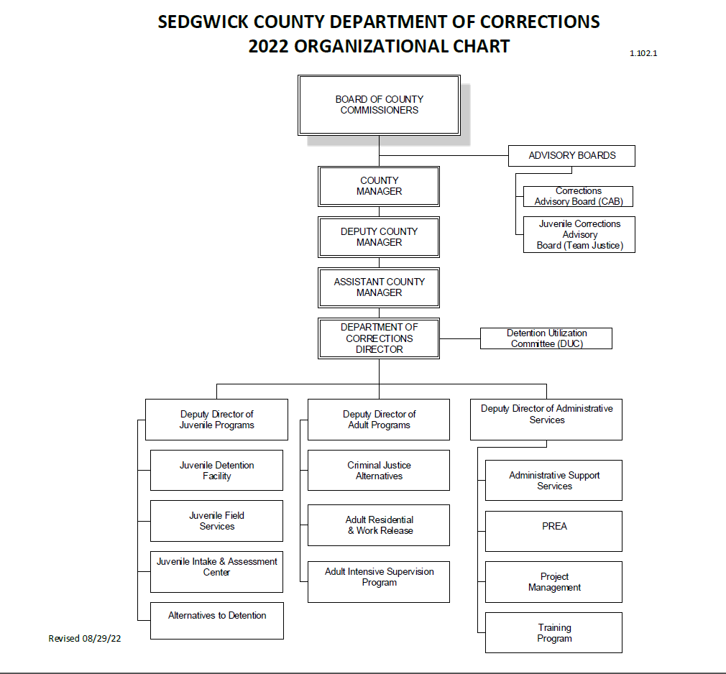

Slide 8

DOC Directors
1995 - 2023

Slide 9
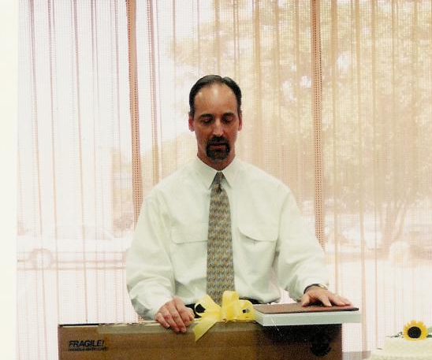
Ken Hales, Director
1995 – 1997

Slide 10
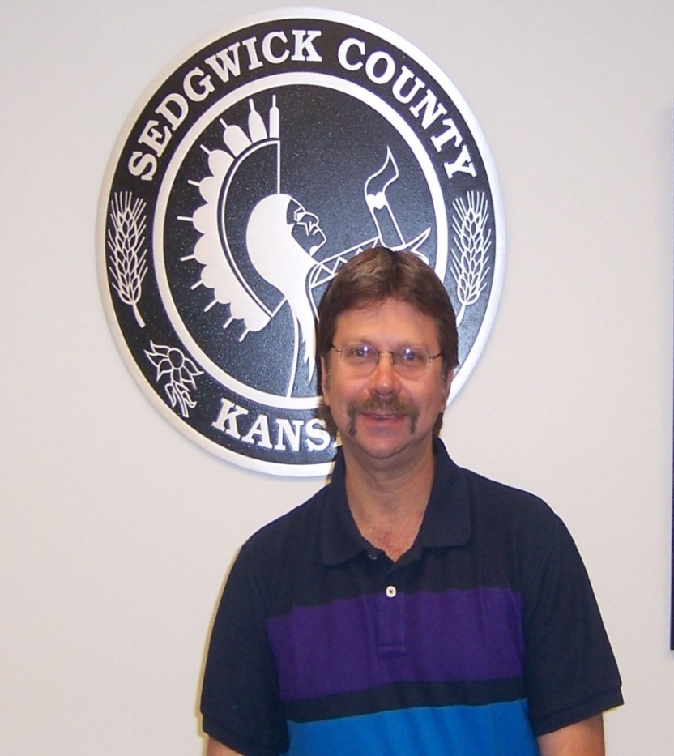
Mark Masterson, Director
1998 – 2016

Slide 11
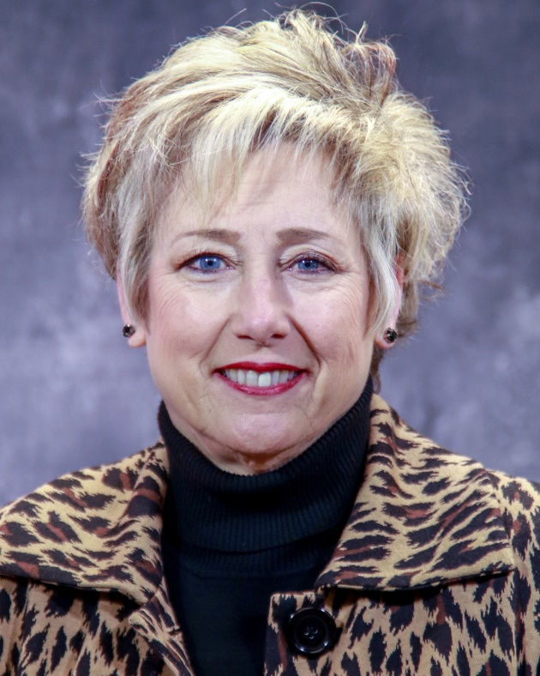
Glenda Martens, Director
2016 – 2021

Slide 12
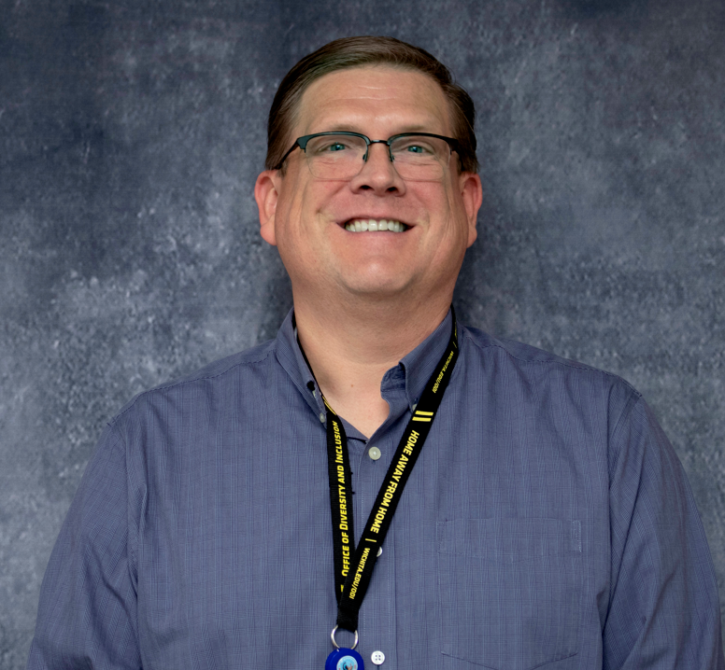
Steven Stonehouse, Director
2022 – Present

Slide 13
Advisory Board Chairs
1995 – 2023

Slide 14
Community Corrections
Advisory Board Chairs
1995 - 96 Galan M. Janeksela
1997 - 98 Douglas R. Roth
1999 - 01 Terri Moses
2002 - 03 Amy Cullom
2004 - 06 Ann Swegle
2007 - 10 Robert Hinshaw
2011 Bruce Kouba/Ann Swegle
2012 - 13 Deanna Carrithers
2014 Kelli Grant
2015 Peter Shay
2016 – 17 Ann Swegle
2018 Kelli Grant
2019 Kelli Grant
2020 Kelli Grant
2021 Ann Swegle
2022 Michael Birzer
2023 Michael Birzer

Slide 15
Juvenile Justice
Advisory Board Chairs
1999 - 01 Margalee Wright
2002 - 06 Karen Langston
2007 - 13 Terri Moses
2014 Ron Paschal
2015 - 16 Terri Moses
2017 Mark Masterson
2018 Shantel Westbrook
2019 Terri Moses
2020 Karen Countryman- Roswurm
2021 Kellie Hogan
2022 Mark Masterson
2023 Kristin Peterman

Slide 16
Program Locations
1995 – 2023

Slide 17
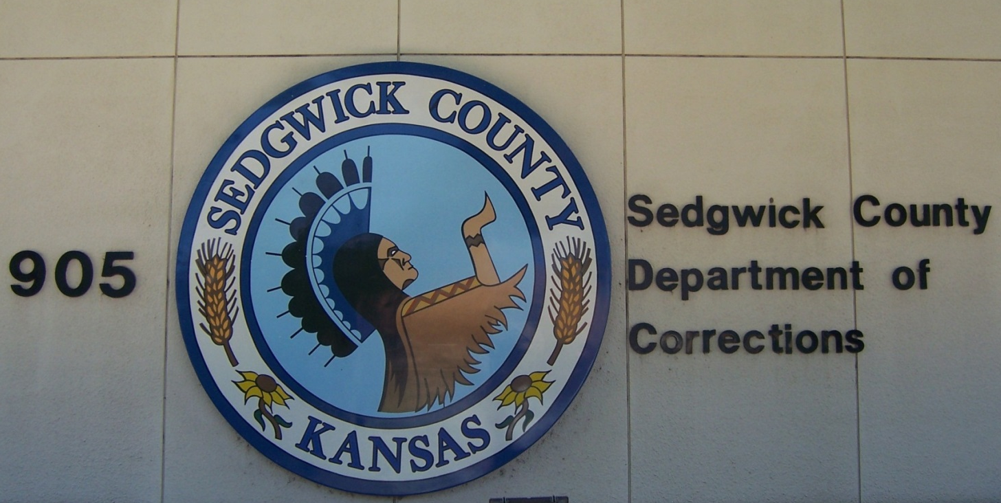
Administration
905 N. Main
1995 - 2006
Notes:
Acquired building in 1989, CC administration moved here – DOC Administration began here in 1995 and then moved to the new JDF in 2006.

Slide 18
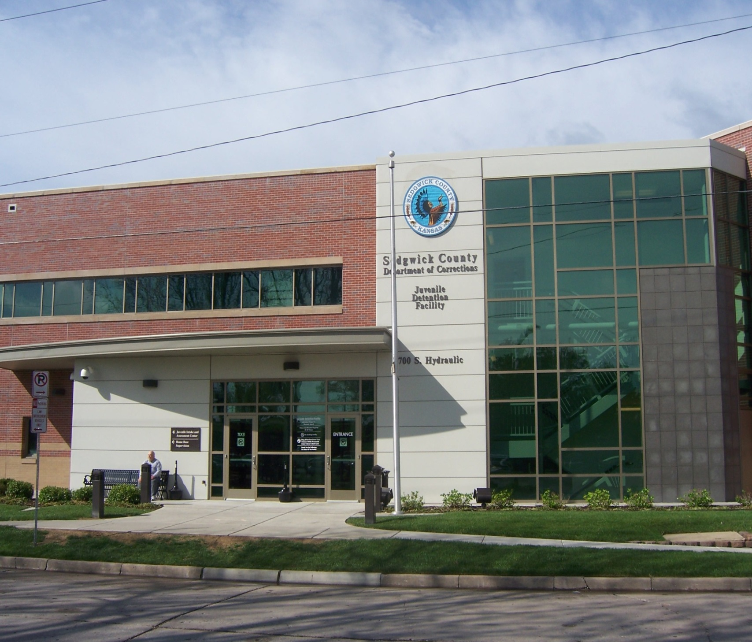
Administration
700 S. Hydraulic
2006 - present

Slide 19
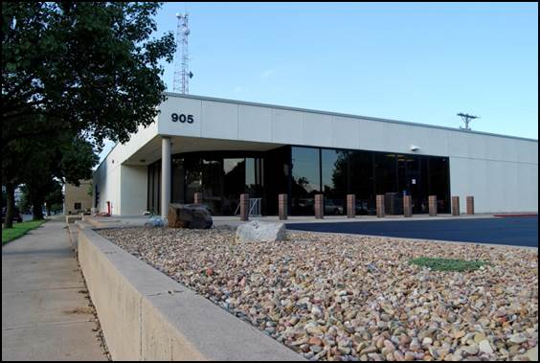
Adult Intensive Supervision
905 N. Main
1989 - present
Notes:
Acquired building in 1989, AISP moved here. Remains here in 2015.

Slide 20
Pretrial Services Program
905 N. Main
1994 – 2009 / 2022 – Present
Notes:
PSP created om 1994. Moved to CJA division in 2009.

Slide 21
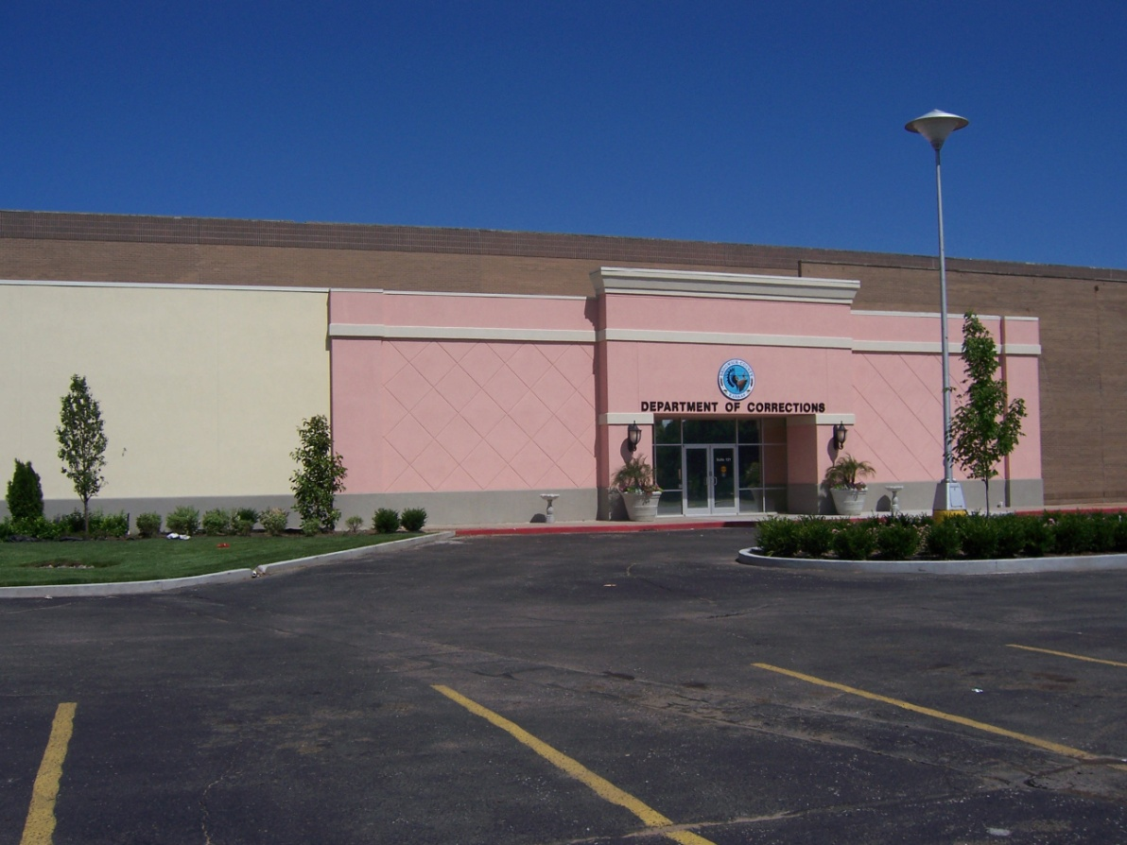
Criminal Justice Alternatives
Drug Court & Pretrial Services Program
3803 E. Harry, Suite 121
2009 - 2022
Notes:
Check dates

Slide 22
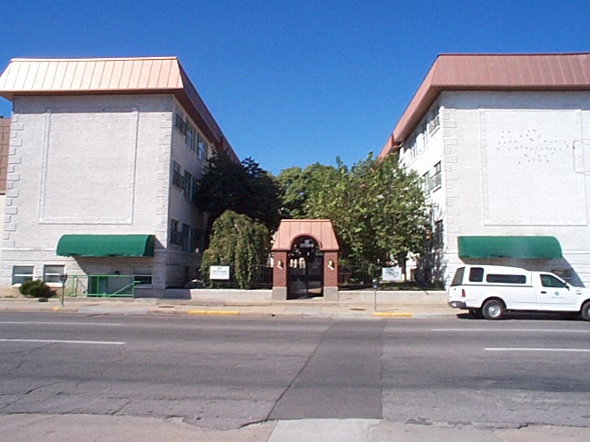
Adult Residential
207/209 N. Emporia
1989 – 2001
Notes:
Buildings purchased in 1989, left facilities in 2001.

Slide 23
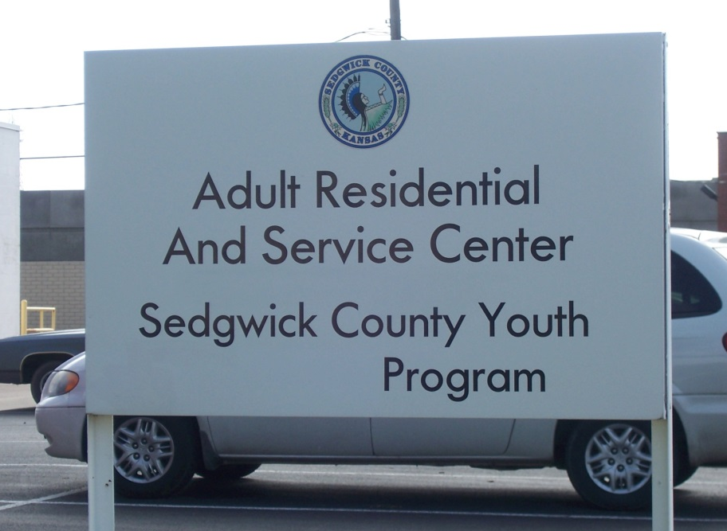
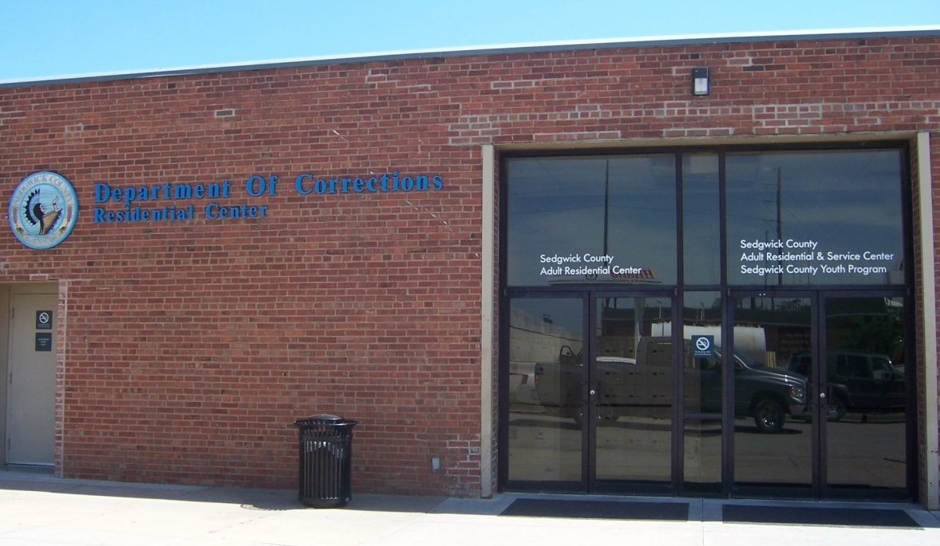
Sedgwick County Work Release
622 E. Central/623 E. Elm
2001 - Present
Notes:
Adult Residential facilities moved here in 2001
SCYP program moved to new location ??

Slide 24
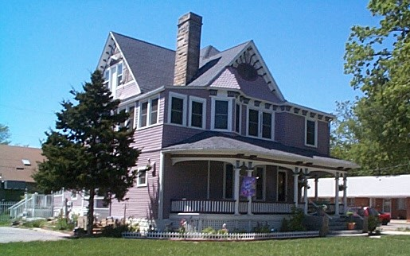
Sedgwick County Youth Program
1025 N. Market
1984 – 1997

Slide 25
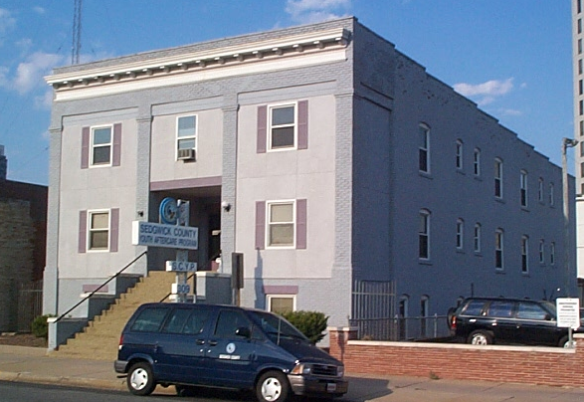
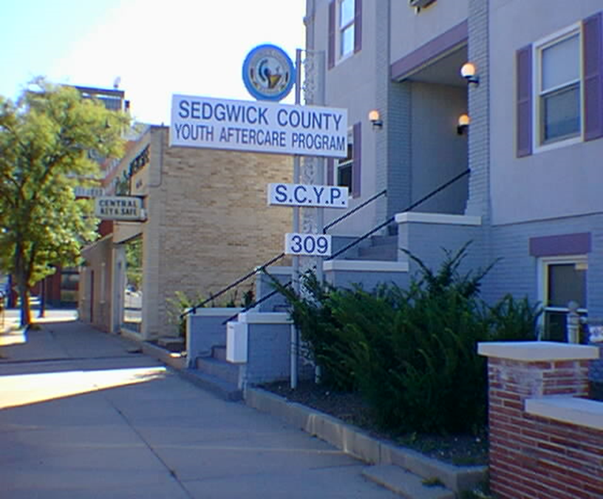
Sedgwick County Youth Program
309 N. Market
1997 – 2002

Slide 26
Sedgwick County Youth Program
622 E. Central/623 E. Elm
2002 - 2017
Notes:
Adult Residential facilities moved here in 2001
SCYP program moved to new location ??

Slide 27
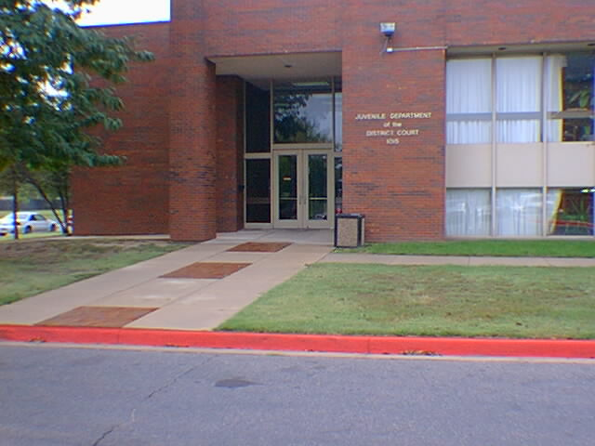
Juvenile Intensive Supervision
Juvenile Courthouse
1015 S. Minnesota
1988 - 1998

Slide 28
Juvenile Intake Services
Juvenile Courthouse
1015 S. Minnesota
1988 - 2007

Slide 29
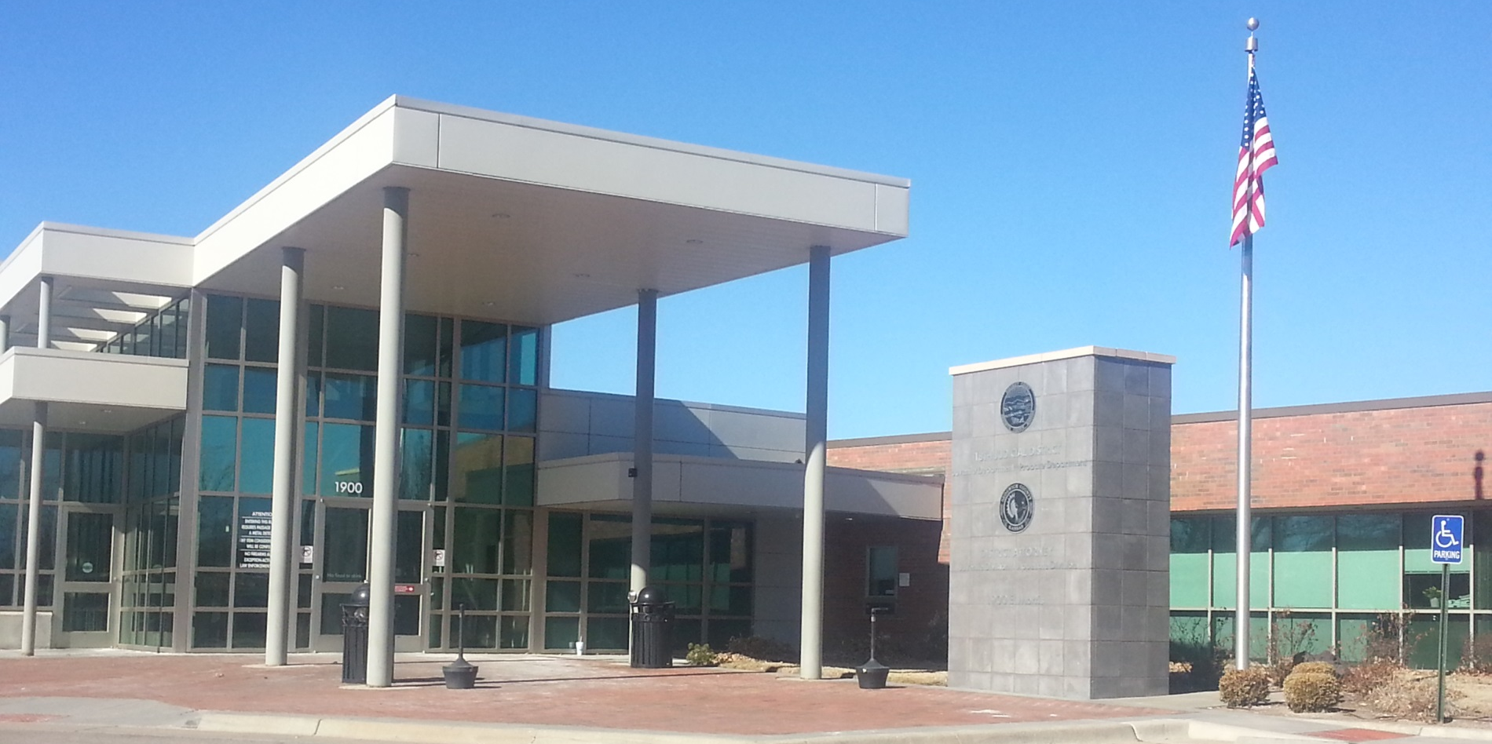
Juvenile Intake Services
Juvenile Courthouse
1900 E. Morris
2007 - present

Slide 30
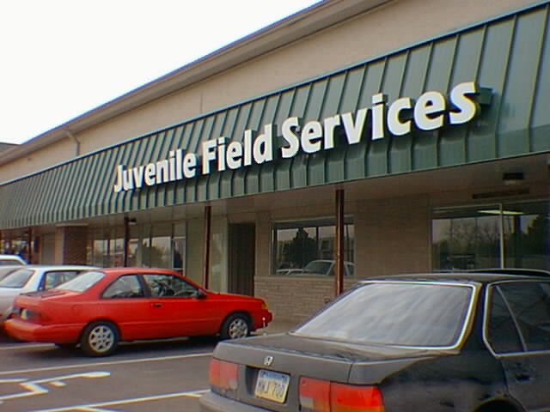
Juvenile Field Services
(Juvenile Intensive Supervision & Juvenile Case Management)
961 S. Glendale
1998 - 2009

Slide 31
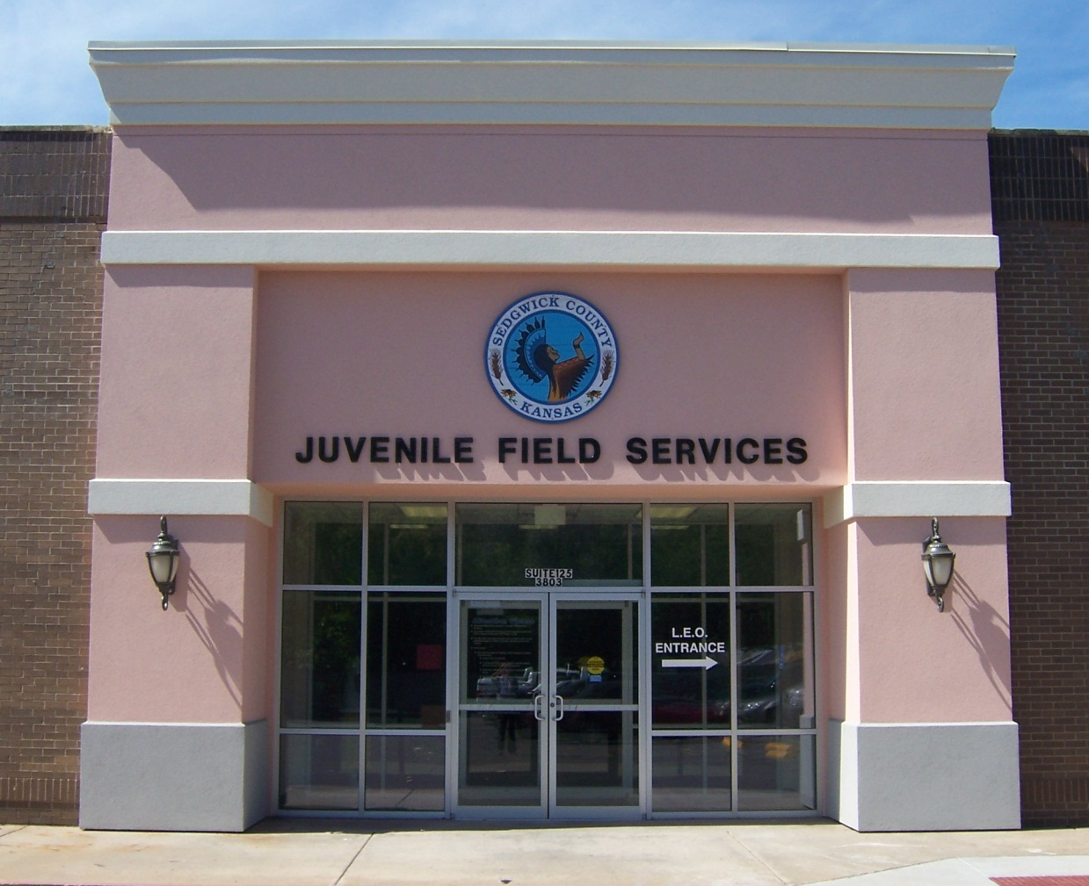
Juvenile Field Services
(Juvenile Intensive Supervision & Juvenile Case Management)
3803 E. Harry, Suite 125
2009 - 2022

Slide 32
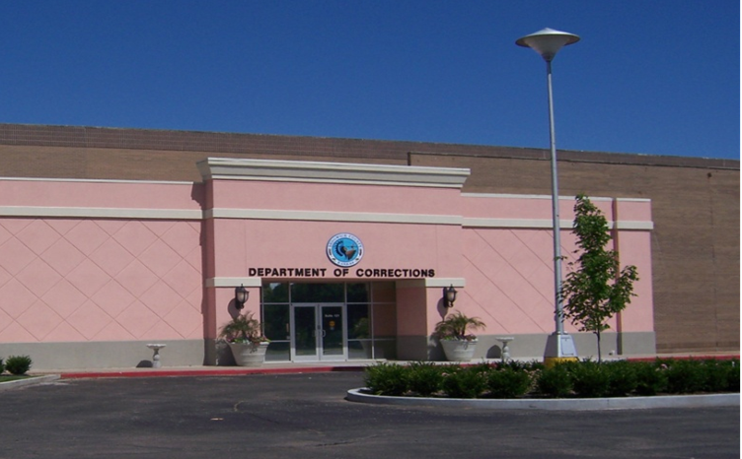
Juvenile Field Services
(Juvenile Intensive Supervision & Juvenile Case Management)
3803 E. Harry, Suite 121
2022 - present

Slide 33
Juvenile Field Services
Evening Report Program (ERC)
3803 E. Harry, Suite 125
2018 - 2022

Slide 34
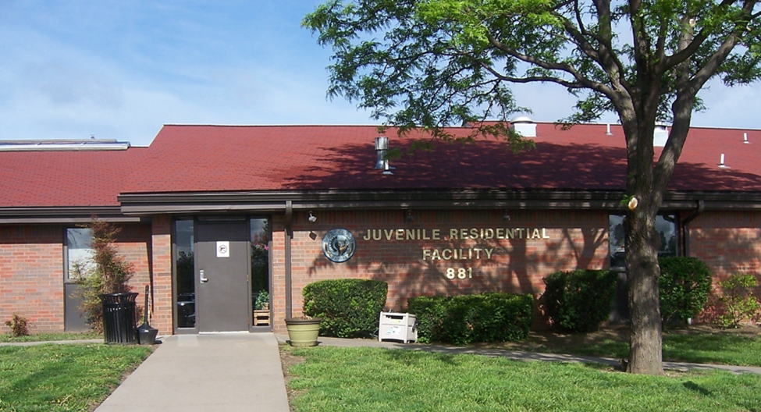
Juvenile Field Services
Evening Report Program (ERC)
881 S. Minnesota
2022 - present

Slide 35
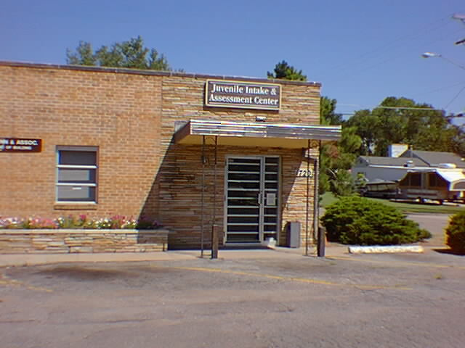
Juvenile Intake & Assessment Center
1720 E. Morris
1996 - 2006

Slide 36
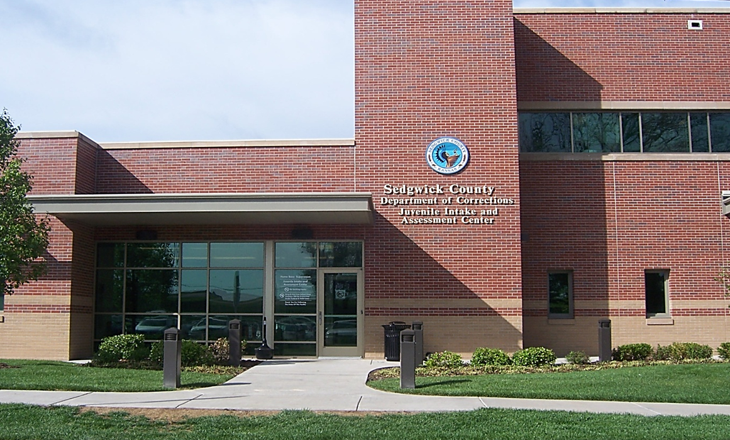
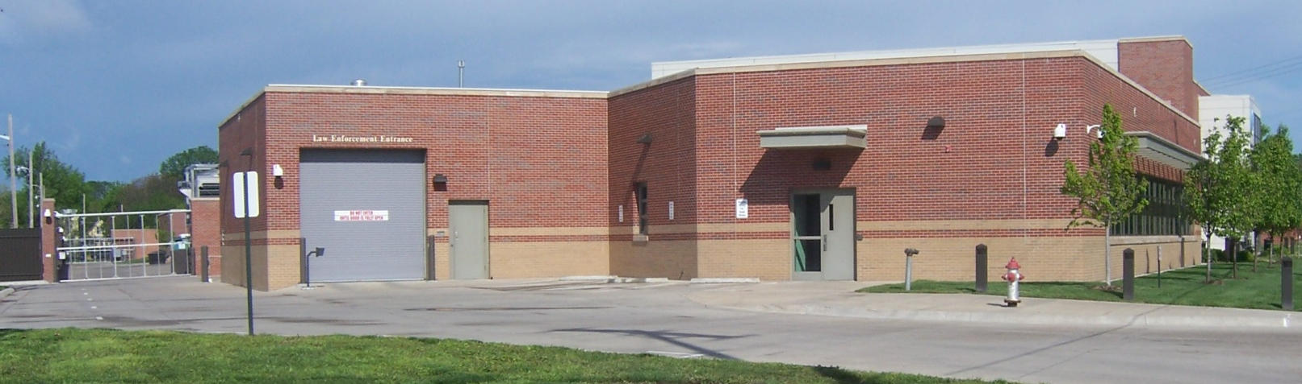
Juvenile Intake & Assessment Center
700 S. Hydraulic
2006 - present

Slide 37
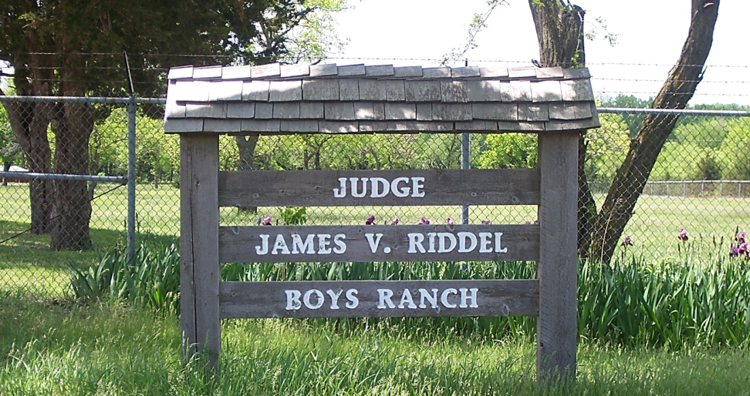
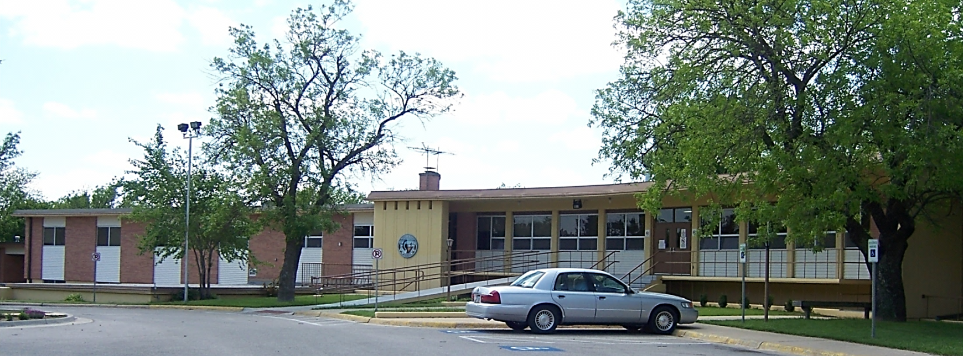
Judge Riddel Boys’ Ranch
25331 W. 39th St. S., Goddard
1960s - 2014

Slide 38
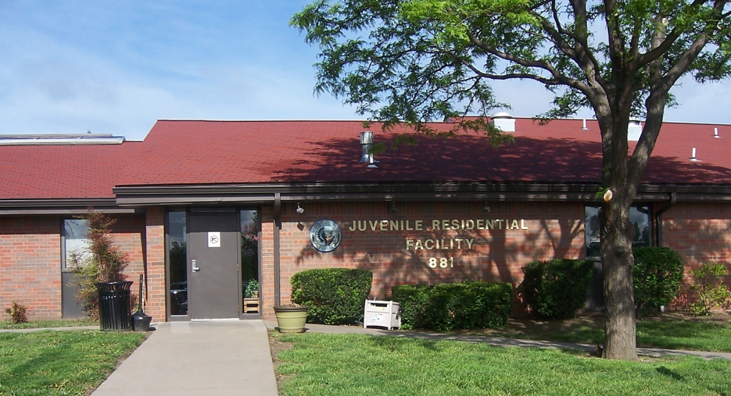
Juvenile Residential Facility
881 S. Minnesota
1994 - present

Slide 39
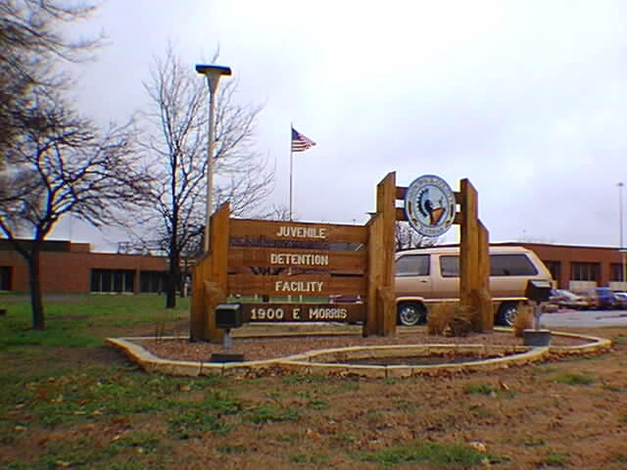
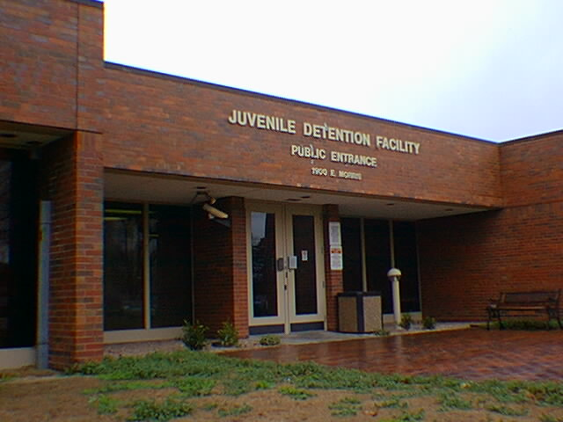
Juvenile Detention Facility
1900 E. Morris
1970s - 2006
Notes:
1990 – HBS started

Slide 40
Juvenile Detention Facility
700 S. Hydraulic
2006 - present

