Slide 1
Sedgwick County Individual Justice Plan (IJP) Overview

Slide 2

Acronyms Preview
CAD – Computer Aided Dispatch
CBS – Community Based Services
CYPM – Cross-Over Youth Practice Model
DCF – Department for Children and Families
DOC – Department of Corrections
IJP – Individualized Justice Plan
IDD – Intellectual / / Developmental Disability
MH – Mental Health
MDT – Multi-Disciplinary Team
LEO – Law Enforcement Officer
ROI – Release(s) of Information
SACK – Substance Abuse Center of Kansas
SED – Serious Emotional Disturbance
TCM – Targeted Case Management
SCCDO – Sedgwick County Developmental Disability Organization

Slide 3
What is an IJP ?
A guide for what works best for an individual with Intellectual / Developmental Disability and/or a Mental Health Disorder, who is exhibiting a pattern of escalating behaviors and has an elevated risk of justice involvement.
Developed in partnership with the identified agency, stakeholders, individual, and their guardian.
IJP document includes an assessment of the individual’s needs and a support plan to address those needs in the community.

Slide 4
Benefits of Individual Justice Plans
Recognize behaviors caused by diagnoses
Prevent justice system involvement
Plan for and support individual success
Increase community collaboration
Inform first responders and law enforcement

Slide 5
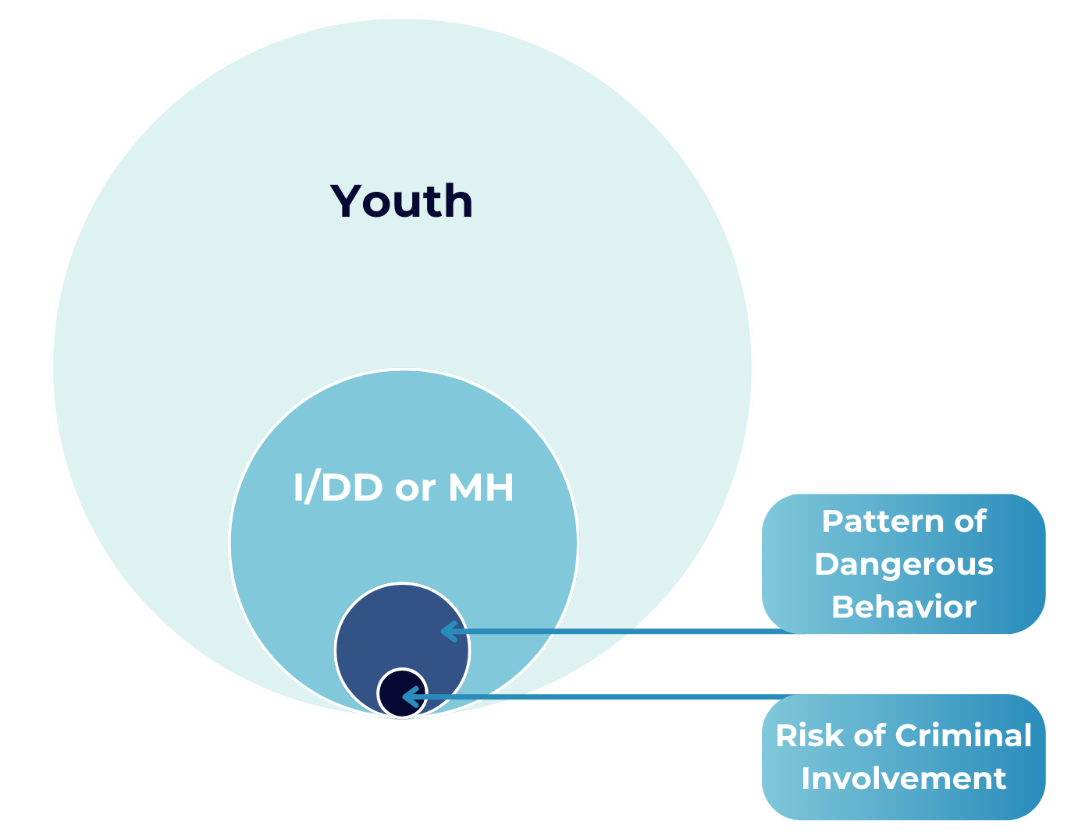
IJP-Identified Population
Notes:
Youth with an Intellectual / Developmental Disability (I/DD) and/or Mental Health (MH) Disorder, who has exhibited a pattern of dangerous behavior and has an elevated risk of justice involvement or who is currently involved in the criminal justice system.

Slide 6
Possible Referral Sources
Individual and/or Guardian
DCF
DOC
Child welfare provider
Court
Education Services
IDD service provider
Mental Health service provider
MDT/Cross-Over Youth Practice Model
Notes:
Individual / guardian
Department for Children and Families (DCF)
Department of Corrections (DOC)
Child welfare provider
Court (judge, attorney, advocate, court service officer, etc.)
Education Services (counselor, teacher, administrator, IEP team, special education, etc.)
I/DD service provider
Mental Health service provider
MDT / Cross Over Youth Practice Model (CYPM)

Slide 7
IJP MDT Committee
COMCARE Crisis
COMCARE Rehab Services
Developmental Disability Organization (SCDDO)
Department of Children and Families (DCF)
Department of Corrections (DOC)
____________
____________
Notes:
Sedgwick County COMCARE Crisis
Sedgwick County COMCARE Rehab Services
Sedgwick County Developmental Disability Organization (SCDDO)
Department of Children and Families (DCF)
Sedgwick County Department of Corrections (DOC)
St. Francis Ministries
____________
____________

Slide 8
IJP Development Process
Voluntary agreement by individual / Guardian
Releases of Information for all-involved parties to IJP
Development by
  Service Provider, or
  Referral to DOC
Review by IJP Multi-Disciplinary Team (MDT)
  Service providers can complete the IJP process and request an IJP MDT review
  Referrals sent to DOC for initiation require IJP MDT review
Notes:
An IJP can be developed by a service provider or referred to DOC for initiation.
Service providers can complete the IJP process and request an IJP MDT committee review if applicable.
Referrals sent to DOC for initiation require IJP MDT Team committee review.
The individual and guardian must voluntarily agree to the Sedgwick County IJP process.
A Release of Information is required for all parties.

Slide 9
IJP Development Process, Continued
Team completes IJP Plan and IJP
Providers request IJP MDT meeting
Send all IJP materials and Release of Information to DOC_IJP@Sedgwick.gov
Upon receipt, DOC:
  Retains Records
  Facilitates an IJP MDT meeting, if applicable
  Sends IJP Snapshot to LEO representative for CAD upload
Notes:
The IJP Plan and IJP Snapshot are completed with identified team members
Providers can schedule a IJP MDT Committee meeting if applicable
Send all IJP materials and release of information to DOC_IJP@Sedgwick.gov
DOC provides records retention and facilitates an IJP MDT meeting if applicable
DOC sends IJP Snapshot to LEO representative for CAD upload based on address and/or name.

Slide 10
IJP MDT Committee
Roles & Responsibilities
IJP MDT Committee Involvement:
Review IJP’s completed by community providers
Schedule with community partner
Review IJP
Multiple disciplines representing community services
Notes:
The IJP MDT committee may review IJP’s completed by community providers if requested. Referrals sent to DOC for initiation shall be scheduled with a community partner and reviewed by the IJP MDT committee. The IJP MDT committee is formed with representation from multiple, relevant support individuals and agencies.

Slide 11
IJP MDT Lead Responsibilities
Finalizing ROIs
Filing and records retention
Submit IJP Snap Shots to the CAD
Organizing meetings to review IJPs in crisis moments
  Within two (2) business days of utilization of an IJP:
    DOC shall schedule an IJP MDT meeting
    Review the incident and identify if the IJP:
      Worked
      Has areas for improvement
      Discuss next steps if stabilization is required
    Identify next steps
Schedule/Facilitate meetings and record keeping
Ensure IJPs are reviewed at least annually
Facilitate IJP destruction process
Notes:
DOC shall serve as the IJP Lead for the committee and be responsible for:
Finalizing, preserving and verifying releases of information are documented prior to filing documents and scheduling meetings.
Filing and records retention for all completed IJP’s for Sedgwick County.
Submit IJP Snap Shots to the CAD system for alert-based notifications related to the youth’s address and name.
Organizing and scheduling committee meetings to review IJPs in crisis moments.
Within two (2) business days of utilization of an IJP, DOC shall schedule an IJP MDT meeting. The IJP MDT meeting shall review the incident and identify if the plan worked, areas for improvement and discuss next steps if stabilization is required.
Scheduling and facilitation of meetings and record keeping functions.
Ensure IJPs are reviewed at least annually.
Facilitate IJP retention and destruction schedules.

Slide 12
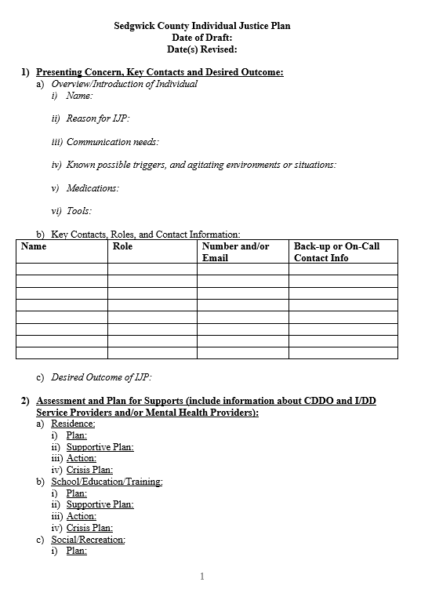
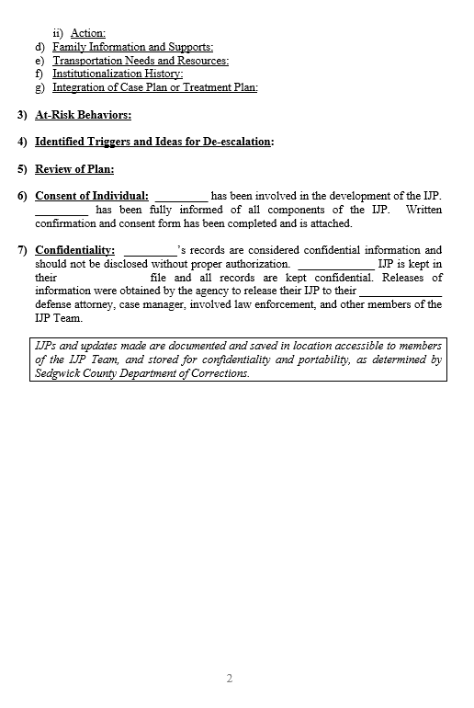

Slide 13
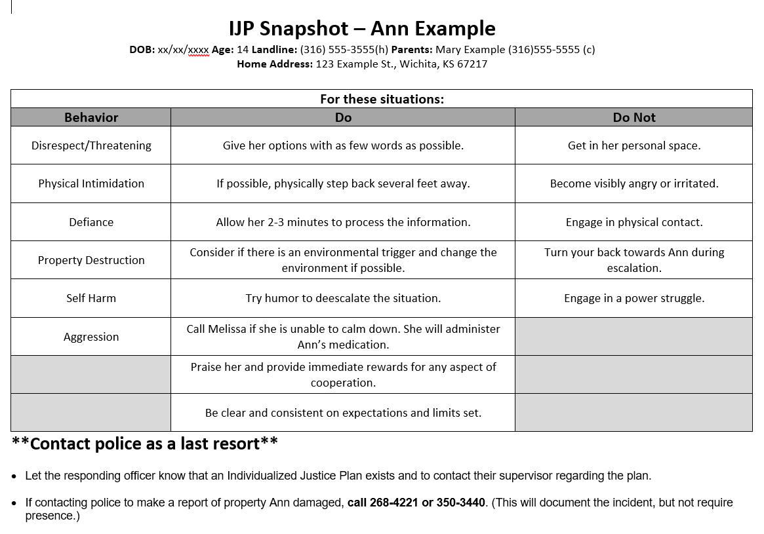

Slide 14
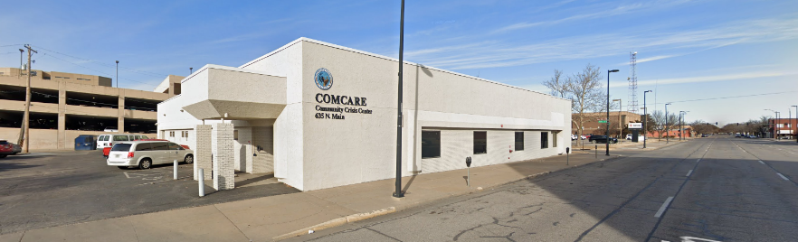
COMCARE Crisis
24/7 Suicide Prevention
  Walk-in Assessments
  988 and Crisis Lifeline
Screening for hospital
Mobile Crisis Response
ICT 1-5
911 Partnership
Adult liaison, case management, justice diversion initiatives
Crisis Stabilization (Adult and Child)
Partnership with SACK
Notes:
24/7 Suicide Prevention
Walk-in Assessments
988 and Crisis Lifeline
Screening for hospital
Mobile Crisis Response
ICT 1-5
911 Partnership
Adult liaison, case management, justice diversion initiatives
Crisis Stabilization (Adult and Child)
Partnership with Substance Abuse Center of Kansas sobering and social detox services

Slide 15
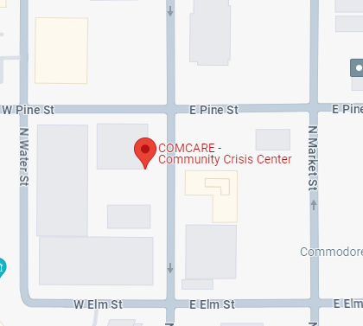
How will COMCARE Crisis utilize IJP?
Allows staff assessing youth to understand what works well and what to avoid
Staff can use IJP as a guide when creating plans for safety
Helps with consistency in responses across settings

Slide 16
COMCARE Same-Day Assessment
Same-Day Assessment Considerations:
First come, first served basis
Not guaranteed
If unable to see same-day, options will be given
Anyone can refer to COMCARE
What to Expect:
About 45 minutes to 2 hours, once with a clinician
Adult Services and Children’s Services have different Same-Day Assessment information
More information can be found here COMCARE Same-Day Assessment Information (https://www.sedgwickcounty.org/comcare/accessing-services/)
Notes:
Same-Day Assessment Considerations: Intakes will be offered on a first come, first served basis. Same-Day Assessment Intakes are not guaranteed. If we have reached our scheduling capacity, options to complete an intake will be provided.
Who can refer to COMCARE?
Individuals do not need a referral to access COMCARE’s programs and services. COMCARE accepts referrals from family members, physicians, hospitals, therapists, the legal system, community agencies, place of employment and other concerned persons.
What to Expect:
COMCARE offers individuals and families several options to complete an intake. Same-Day Assessment is an option available to anyone interested in mental health and addiction services with no appointment required.
The assessment process to take 45 minutes, up to two hours, once seated with a clinician. We suggest filling out paperwork ahead of time to help expedite processes.
Psychological Evaluations and court ordered mental health assessments are not the same service as an intake for services and will not be provided at the Same Day Assessment.
Adult Services and Children’s Services have different Same-Day Assessment information based on programming requested. More information can be found here COMCARE Same-Day Assessment Information.

Slide 17
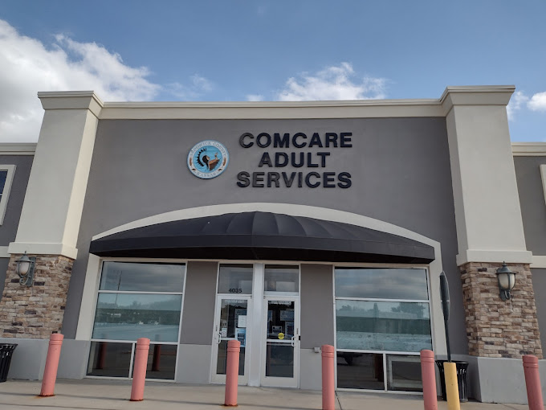
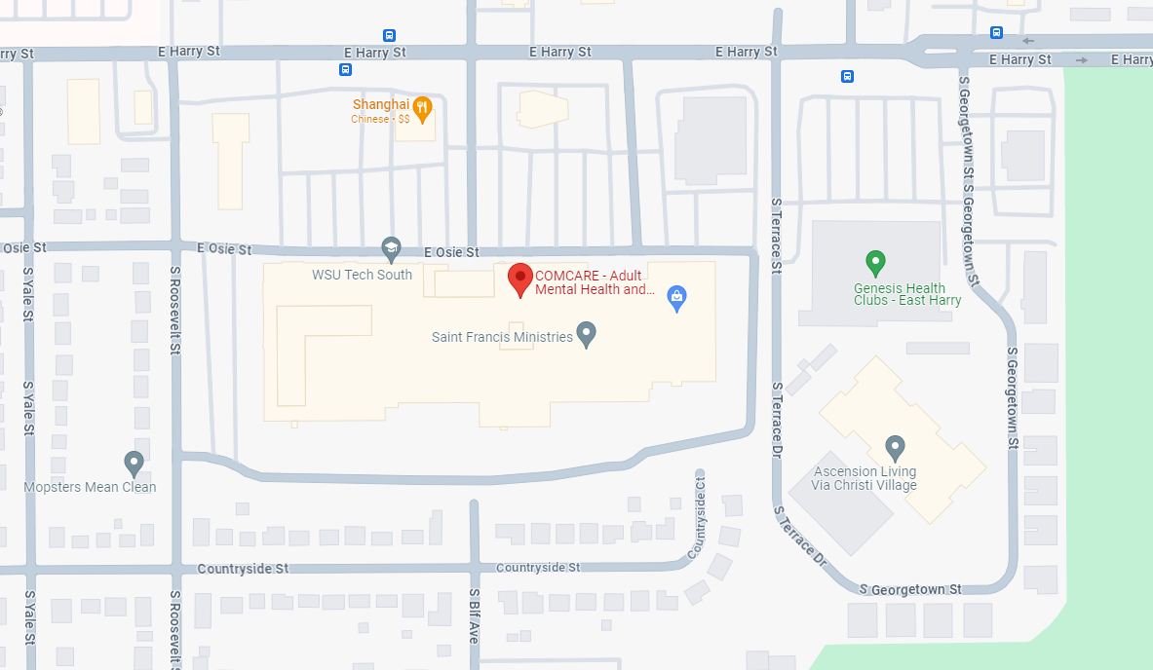
COMCARE Adult Services (AS) Rehab
Addiction Treatment Services (ATS)
  Assessment and evaluation
  Co-occurring mental health and substance use treatment
  Substance Use Disorder group and individual treatment
  Alcohol and drug education programs
  Problem gambling treatment
Community Support Services and Center City (CSS and CC): 1:1 or in group settings
  Must meet criteria as PRE or Severe Persistent Mental Illness
PATH Outreach: The goal of PATH is to assist those who are currently unhoused access services to increase permanent housing. Supportive services:
  mental health treatment
  basic needs
  housing resources
Outpatient Services (OPS): Individual and Group mental health therapy
Notes:
Adult Services (AS)
Addiction Treatment Services (ATS)
Serves individuals 18 years of age and older.
Provides the following: Assessment and evaluation, co-occurring mental health and substance use treatment, substance Use Disorder group and individual treatment, alcohol and drug education programs, addresses problem gambling.
Community Support Services and Center City (CSS and CC)
Serves individuals 18 years of age and older.
Must met state defined assessment criteria as PRE or Severe Persistent Mental Illness
Individual has expressed an interest in improving mental health symptoms
Services are designed to assist people recover and reclaim their lives by identifying, securing, and sustaining the range of resources needed to live, work, and play as fully integrated citizens of the communities in which they live. Services may be provided one-on-one or in a group setting.
PATH Outreach
Funded by a grant from KDADS. The goal of PATH is to assist individuals in Sedgwick County that are currently unhoused, and meet HUD criteria of being chronically homeless, access services related to mental health treatment, basic needs and housing resources in an effort increase permanent housing and supportive services.
Outpatient Services (OPS)
Serves individuals 18 years of age and older.
Individual and Group mental health therapy

Slide 18
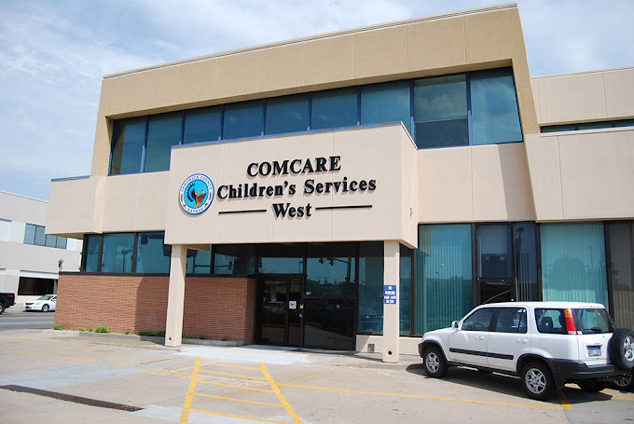
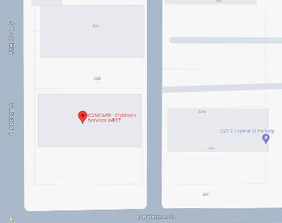
COMCARE Childrens Services (CS) Rehab
< 18 years
Serious emotional & social problems disrupting community
Experiencing an SED
At-risk for out-of-home placement or psychiatric hospitalization
  Community Based Services (CBS): In home; community; school
  Therapy Clinic: Individual and family therapy
  Mental Health Intervention Program (MHIT)
    KSDE COMCARE MHIT Schools (https://www.sedgwickcounty.org/comcare/youth-mental-health/ksde-mhit-program/)
  First Episode Psychosis Program (FEP): Self contained, team-based treatment modality. Limited availability.
    Assertive treatment; individuals; 16-35 years-old
    Onset of psychotic symptoms within the last 5 years
    Some exclusions
Notes:
Children’s Services (CS)
Available to youth younger than 18 years (up to 22 years in certain circumstances) who have serious emotional and social problems that disrupt community, experiencing a Severe Emotional Disturbance (SED), school and family relationships. These children are at risk for out-of-home placement or psychiatric hospitalization.
Community Based Services (CBS)
Primarily services are provided in the home, community, and school settings.
Examples: Integrated Care Case Management Services (ICS), Attendant Care (AC), Psychosocial Individual and Group (PRG/PRI), Parent Peer Support, SED Waiver Services.
Therapy Clinic
Individual and family therapy.
Kansas State Department of Education Mental Health Intervention Program (MHIT)
KSDE MHIT is a program designed to work directly with youth in the school setting. Through extensive work with schools, we are able to reduce the amount of disruption to a youth daily life and increase coordination of care. A list of schools that are part of the MHIT program can be found here KSDE COMCARE MHIT Schools.
First Episode Psychosis Program (FEP)
Self contained, team-based treatment modality. Limited availability.
Provides assertive treatment to 16 years old through 35 years old : Onset of psychotic symptoms in within the last 5 years. Exclusion: Psychosis is due to trauma, substance abuse/abuse, or Traumatic Brain Injury
Individual Therapy, Integrated Care Case Management Services (ICS),, Peer Support, Medication Management, Employment and Education Support, Family Education and Support, Community Education through presentations and consultations.

Slide 19
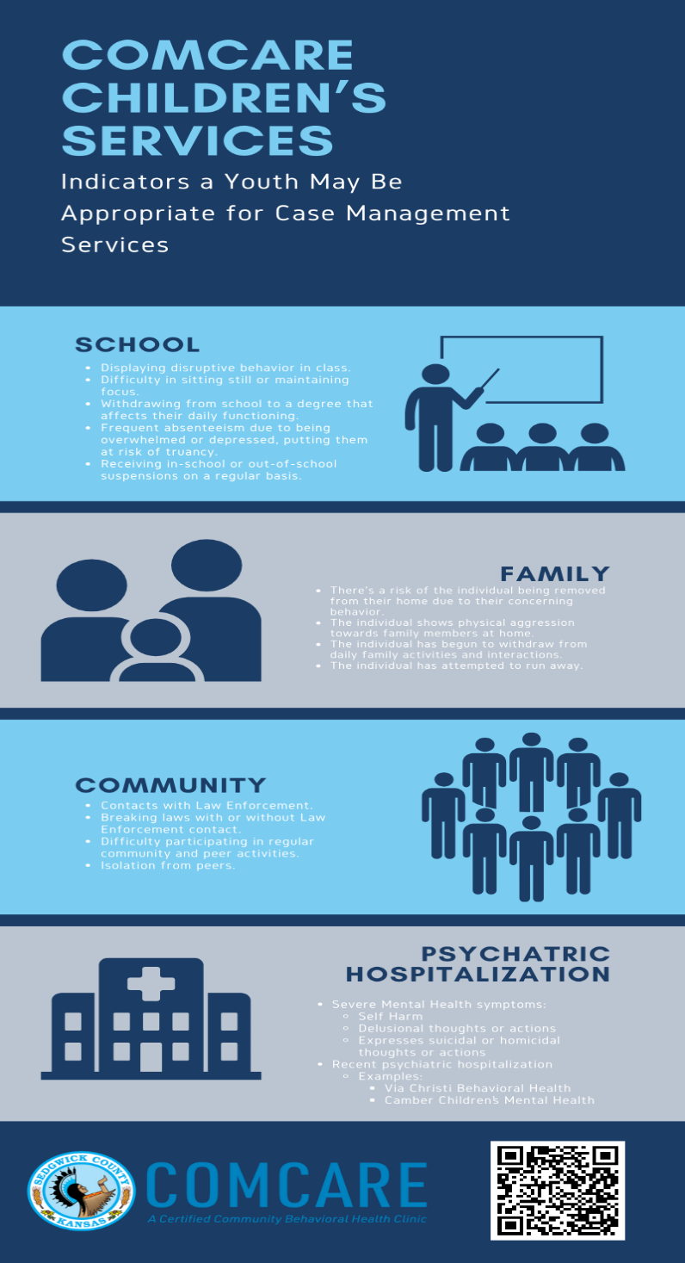
Integrated Care Case Management
Notes:
COMCARE Rehab Services Children’s Services:
Integrated Care Case Management: Indicators referral to Community Based Services (CBS) through COMCARE may be appropriate

Slide 20
COMCARE and the IJP Processes
For youth active in COMCARE Children’s Services, CBS program:
  ICS may recommend an IJP
  ICS may participate as a IJP Team member in development
    feedback related to treatment plan related to Law Enforcement
    may provide current mental health treatment plan
    COMCARE Crisis Plan
  ICS may provide guidance in deescalating the youth
  ICS will support the implementation of the IJP
  ICS will ensure assigned COMCARE providers have access
Notes:
COMCARE Children’s Services providers may receive education and training regarding the IJP development processes.
Youth active in COMCARE Children’s Services, CBS program:
ICS may identify youth from their caseload, that would be appropriate to have an IJP developed.
ICS may participate as a team member, in the development of the IJP, by providing feedback related to the youth's current mental health treatment plan, as it relates to the youth's contacts with Law Enforcement. If approved by the legal guardian via a Release of Information, the ICS, may provide current mental health treatment plan and COMCARE Crisis Plan to assist in the development of the IJP.
ICS may provide guidance, based on their individual interactions with the youth, that may be useful in deescalating the youth and diverting from further Law Enforcement involvement.
ICS will support the implementation of the IJP through the provision of medically necessary mental health services and assist in referral to additional mental health services identified by the IJP development team.
ICS will ensure the completed IJP is available in COMCARE’s Electronic Medical Record, for reference by all COMCARE providers serving the youth.

Slide 21
COMCARE and the IJP Process
For youth active in COMCARE Children’s Services, Therapy Clinic program, only:
  Clinicians:
    may recommend an IJP for a client
    May support a referral to CBS
    May be consulted regarding the youth’s mental health needs
    Likely can’t participate as an IJP Team Member
    Will ensure assigned COMCARE providers have access
For youth not active in COMCARE Children’s Services, but reporting previous involvement:
  With ROI, COMCARE can provide records regarding MH services provided
Notes:
Youth active in COMCARE Children’s Services, Therapy Clinic program only:
Clinician may identify that a youth may be appropriate for an IJP.
It would be anticipated, if the legal guardian is amenable, that a referral to CBS be completed to ensure medically necessary mental health services are provided.
Clinician’s may be consulted regarding the youth’s mental health needs, but in most cases will not be able to participate fully in the development of the IJP as an active team member.
Clinicians will ensure the completed IJP is available in COMCARE’s Electronic Medical Record, for reference by all COMCARE providers serving the youth.
Youth is not active in COMCARE Children’s Services, but reports previous involvement:
If appropriate Release of Information is provided, COMCARE can provide records regarding mental health services provided, based on the need to know of the individual requesting.

Slide 22
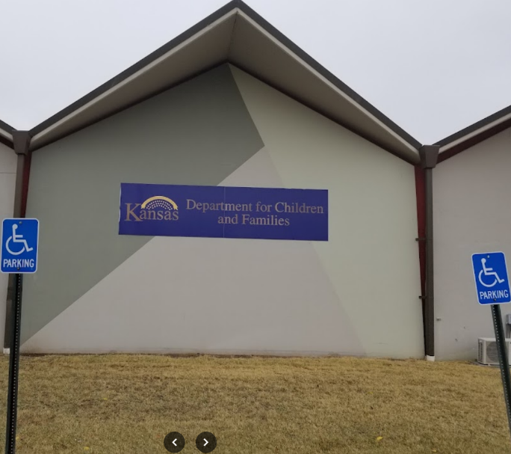

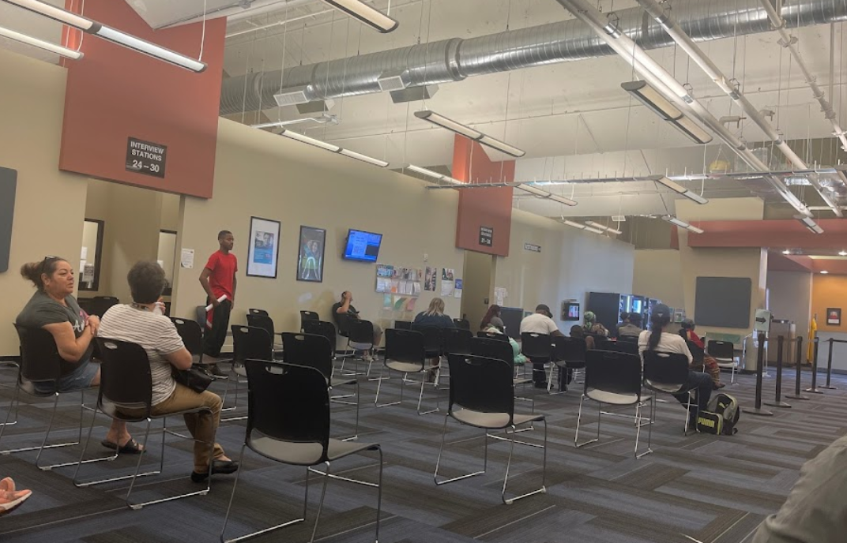
Department for Children and Families
Prevention and Protection Services
  Assessment and Prevention
  Foster Care
  Support Services
Adult Protective Services
Kansas Protection Reporting Center
Rehabilitation Services/Pre-ETS
Economic and Employment Services (EES)
  Cash, food and childcare assistance
  GOALS/Work Programs

Slide 23
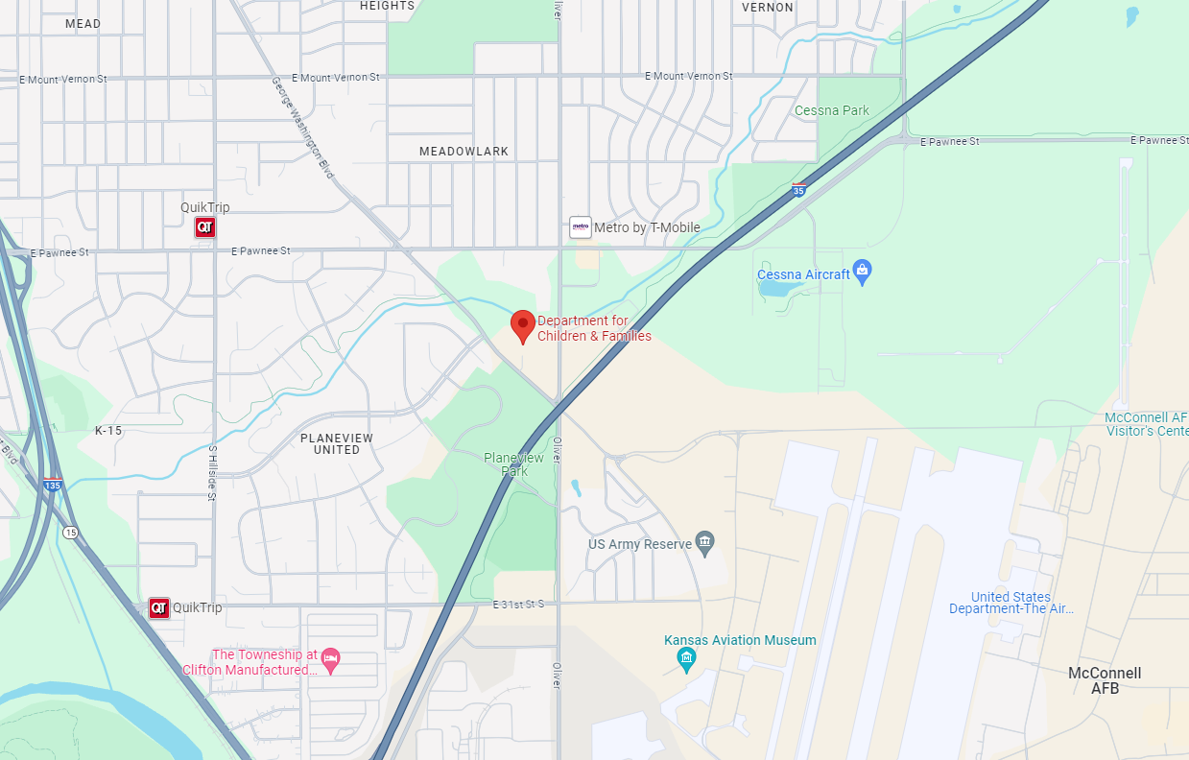
Department for Children and Families
Prevention and Protection Services- Assessment and Prevention
  Serve families at risk for out of home placement
  Focus on prevention in-home support
DCCCA Family Preservation Services
  In-Home Services for families facing child removal risk
  Includes therapeutic support, substance abuse treatment, parent education, and case management
Family First Services
  Diverse services addressing home risk factors
  Substance abuse treatment, mental health, and parent support
Notes:
Prevention and Protection Services- Assessment and Prevention
Assess and provide services to families for whom there is a risk for out of home placement of a child
Primary focus is on prevention and services to support children and families in their homes
DCCCA Family Preservation Services
In-Home Services for families who are at risk of a child being removed from the home
Therapeutic supports, substance abuse treatment, parent education and support, case management
Family First Services
Menu of services to help address risk factors present in a home
Substance abuse treatment, mental health, parent support

Slide 24
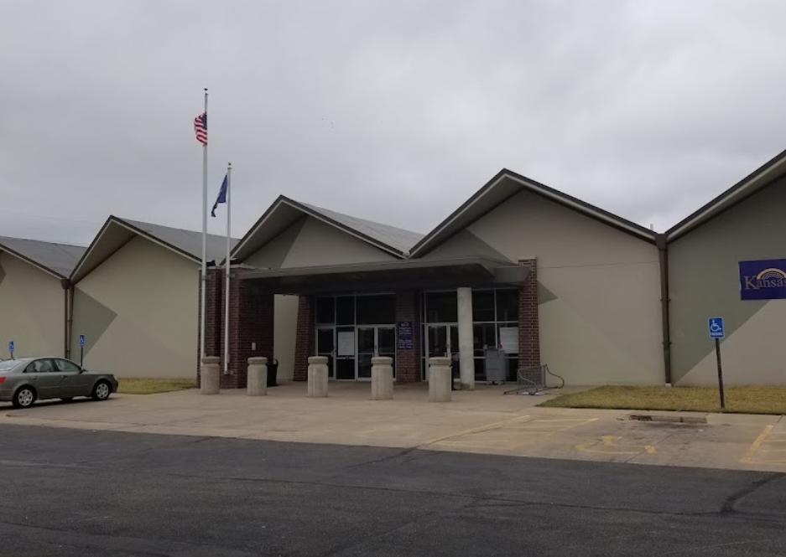
Department for Children and Families
Prevention and Protection Services- Foster Care
  When a child’s safety is compromised at home
  May refer for out-of-home services
Foster Care Case Management Provider (St. Francis Ministries to 6/30; EmberHope after 7/1)
  Case Management services
  Partner with child and family service providers
  Provide information and recommendations to the court
  Focus on achieving timely permanency
Notes:
Prevention and Protection Services- Foster Care
Safety concerns to where a child can no longer remain safely in the home
Referrals for out of home, foster care services
Saint Francis Ministries (SFM)
Case Management services to address the safety concerns that precipitated the out of home case
Partner with community providers for services to the child and family
Work with the court on providing information and recommendations for the Child in Need of Care case
Focus on timely permanency for children in foster care

Slide 25
Department for Children and Families
DCF and IJP Process
DCF, with contracted case management service providers, will help identify youth for whom an IJP may be beneficial
Partner in the development of the IJP process
Train staff in completing the IJP
Maintain records and share IJP with new providers, placements, schools, foster families or relative placements, and bio parents
Support and implement recommendations of the IJP
Notes:
IJP Process
DCF, along with agencies who provide the direct case management services to children and families, will help identify youth for whom an IJP may be beneficial
Partner in the development of the IJP process
Train staff in completing the IJP
Maintain records and ensure new providers, placements, the school, foster families or relative placements, bio parents, etc. receive copies of the IJP
Support the recommendations of the IJP and implement interventions

Slide 26
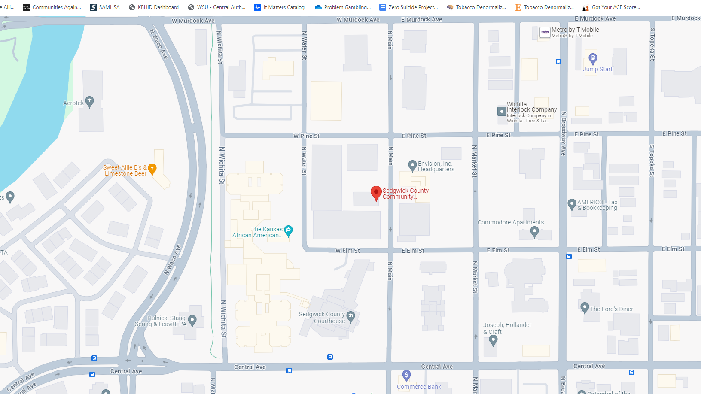
Sedgwick County Developmental Disability Organization (SCDDO)
The SCDDO has 2 primary responsibilities:
  Single Point of Entry to the IDD Service System
    Determines eligibility for IDD services
    Options Counseling
    Conducts Initial and Annual BASIS assessments
  Quality Oversight (QA)
    Monitors Provider Changes
SCDDO does not provide direct services to consumers
Notes:
The SCDDO has 2 primary responsibilities:
Single Point of Entry to the IDD Service System
Quality Oversight (QA)
SCDDO serves as a single point of application & referral for services within the IDD Service System for persons with Intellectual or Developmental Disabilities (IDD)
Determines if a person is eligible for IDD services
Provides information on and explains available services & service providers (Options Counseling)
Conducts Initial and Annual BASIS assessments
Monitors Provider Changes
SCDDO does not provide direct services to consumers

Slide 27

Sedgwick County Developmental Disability Organization (SCDDO)
The IDD Service System includes CDDO and State Aid funded programs, and services funded thru the Home & Community Based Services (HCBS) Waiver:
TCM Services include:
  Assessment
  Development of Service Plan
  Referral & Related Activities
  Monitoring & Follow-up
Waitlist for accessing HCBS funding thru the IDD Waiver
TCM Services can be accessed while on the Waitlist via Medicaid or Private Pay
Targeted Case Management (TCM) Residential Support Day Support Supportive Home Care | Night Support Medical Alert Home Modifications Family Support Funding
Notes:
The IDD Service System includes CDDO and State Aid funded programs, as well as services funded thru the Home & Community Based Services (HCBS) Waiver:
TCM Services include:
Assessment
Development of Service Plan
Referral & Related Activities
Monitoring & Follow-up
In Kansas, there is a Waitlist for accessing HCBS funding thru the IDD Waiver, with the wait currently averaging over 10 years
TCM Services can be accessed while on the Waitlist via Medicaid or Private Pay

Slide 28
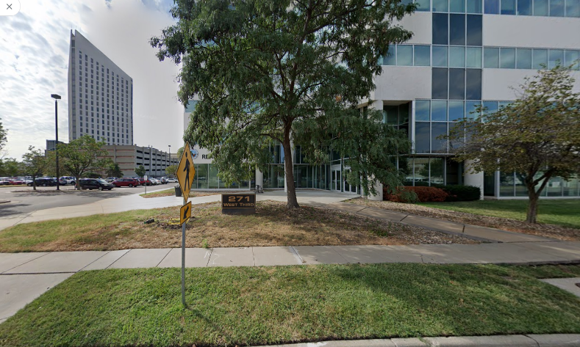
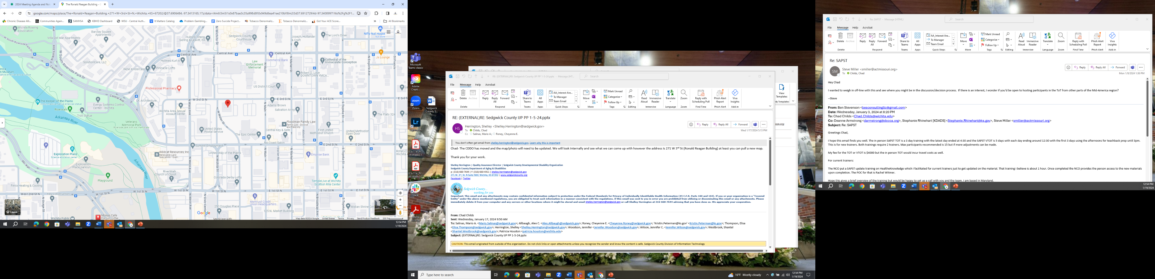
Sedgwick County Developmental Disability Organization (SCDDO)
Ensuring services provided meet regulatory standards
60+ Affiliates in Sedgwick County Provider Network
Works to improve deficiencies, collaboratively
Conducts regular site visits
Coordinates the Quality Assurance Committee
Services can be accessed via TCM or by calling the SCDDO at 316-660-7630 or on the Website at www.sedgwickcounty.org/cddo
Notes:
SCDDO has a role in ensuring services provided meet regulatory standards
Currently there are 60+ Affiliates in the Sedgwick County Provider Network
QA Staff works with these Providers to improve any deficiencies in a collaborative manner
QA Staff also conduct regular site visits & coordinate the Quality Assurance Committee process

Slide 29

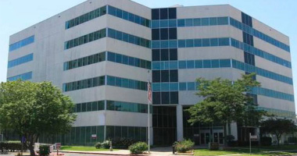
SCDDO and the IJP Process
TCM Providers may receive education and training
  Recordings may be available for viewing on-line within Relias
  Information may be available via Lunch & Learn Sessions
Referral Process
  TCM’s will engage with the DOC for initiation
  Assistance from SCDDO
Development of IJP
  TCM’s can participate as a team member
Implementation
  TCM Providers implementation of IJPs through collaboration as needed
IJP Referrals and related materials can be sent to DOC_IJP@Sedgwick.gov
Notes:
IJP Process
TCM Providers may receive education and training regarding the IJP development processes.
Recordings of IJP Training may be available for viewing on-line within Relias
Information on IJP Process may be available via Lunch & Learn Sessions
TCM’s will engage with the DOC for initiation of referral to the IJP process. The referral process can be assisted by the SCDDO.
TCM’s can participate as a team member in the IJP development process by providing information and resources, as well as identifying the unique strengths and needs of the individual
TCM Providers will support the implementation of the IJP through collaboration with the DOC and other service providers as needed.

Slide 30

1st Responders and Law Enforcement
CAD Update
Notifications
What is shared with responders?

Slide 31

IJP Process
Practice Activity

Slide 32

IJP Process Questions?

Slide 33
THANK YOU!

